Slide 1
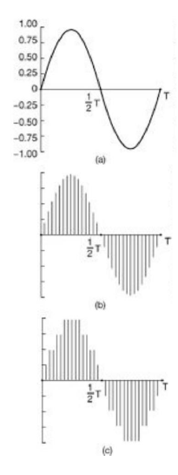
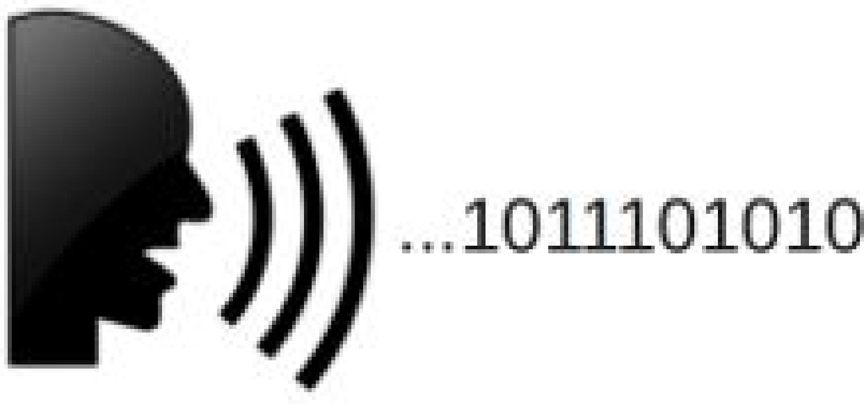
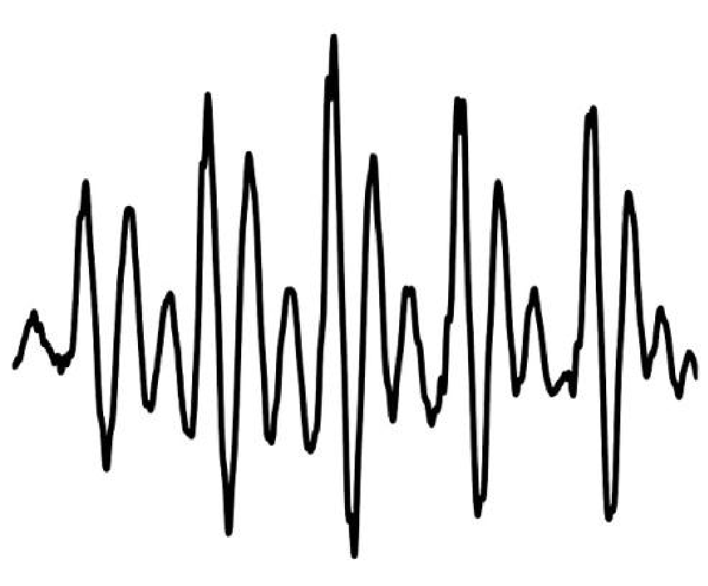
Speech Information Systems
Lab 5
Segmental and suprasegmental elements in speech technology, speech synthesizers in practice and their databases
Author: Ibrahim Ibrahimov, Csaba Zainkó Email: ibrahim@tmit.bme.hu
Academic Year: 2024/2025 – Spring

Slide 2

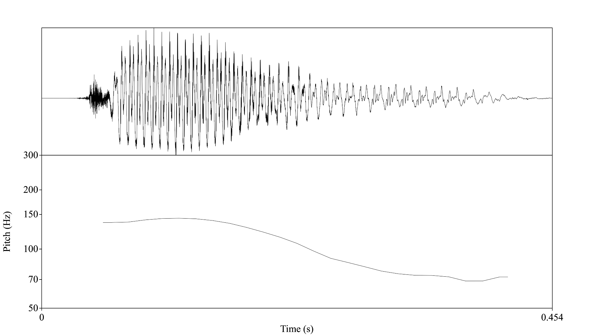
1. When pronouncing the word ”deal”, which part is not found in the speech signal?
Quasi-periodic
Unvoiced
Plosive burst
Silent phase
Mixed excitation

Slide 3
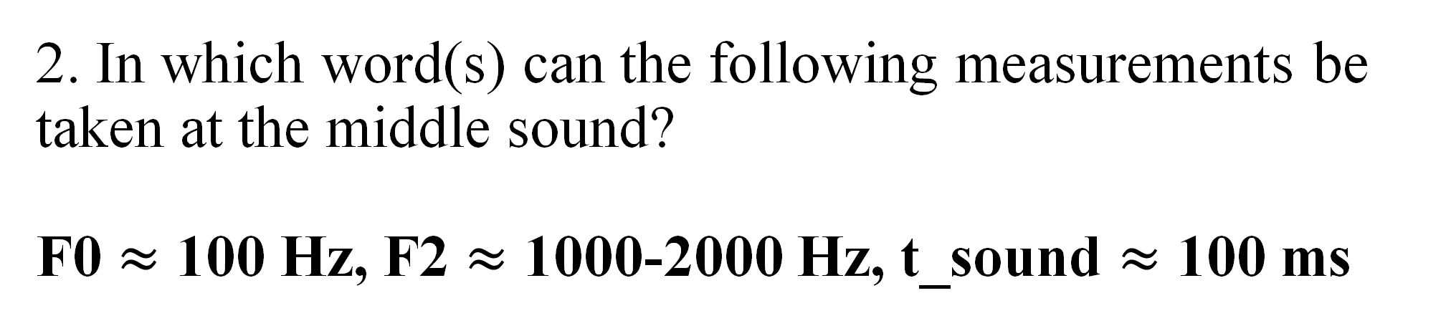
2. In which word(s) can the following measurements be taken at the middle sound? F0 $≈$ 100 Hz, F2 $≈$ 1000-2000 Hz, t_sound $≈$ 100 ms
bet
fun
icy
sit
cat

Slide 4
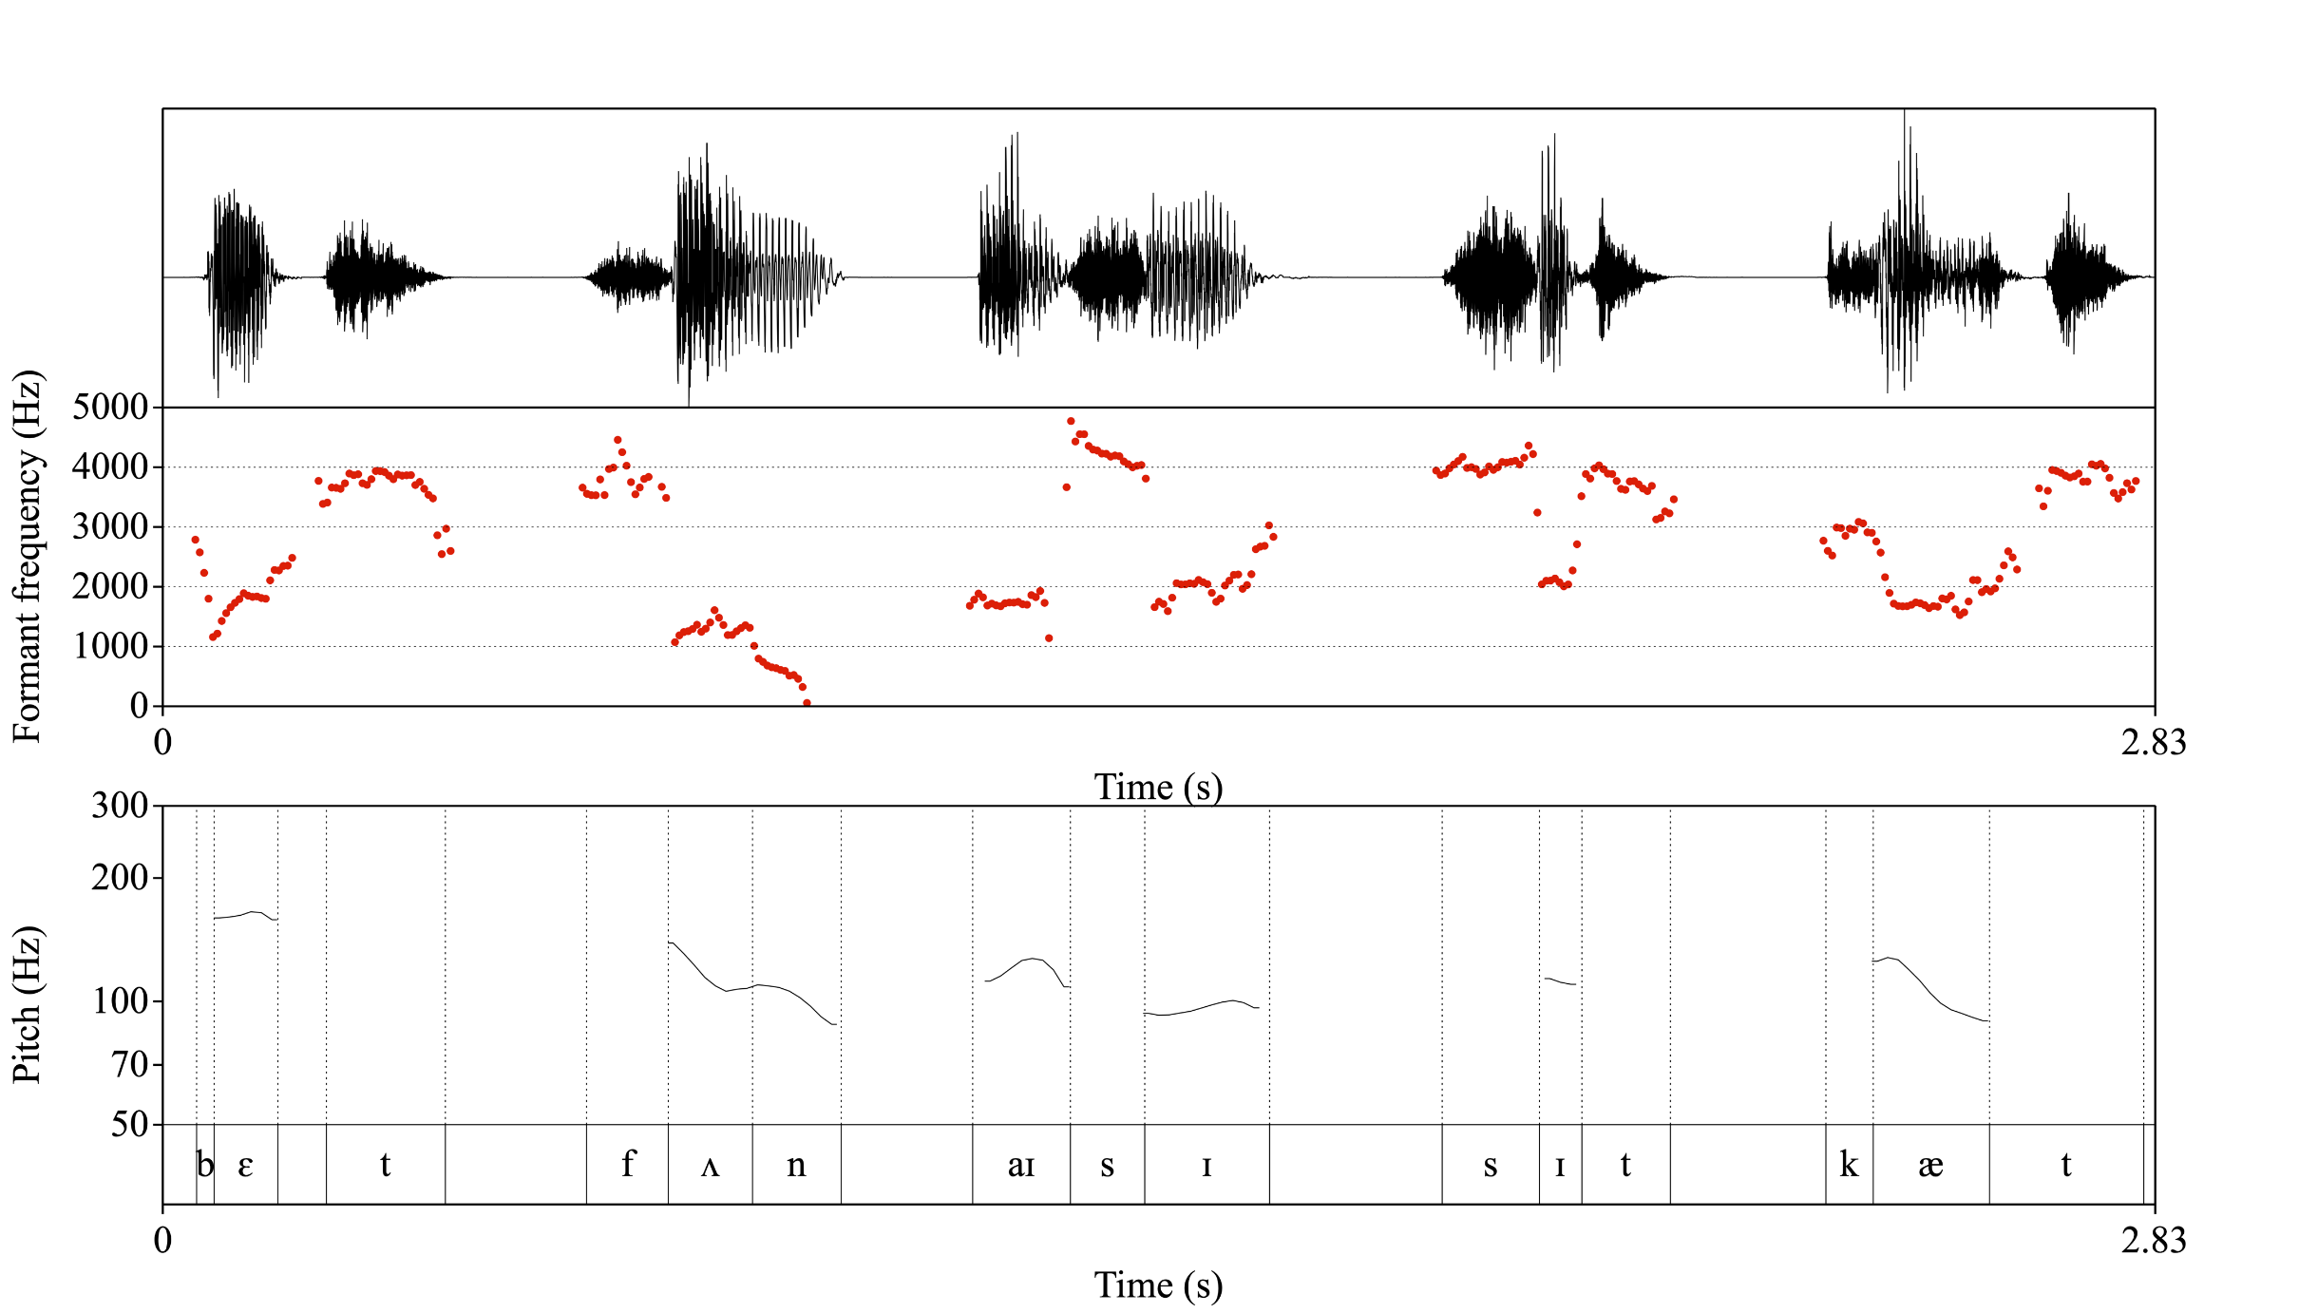

Slide 5
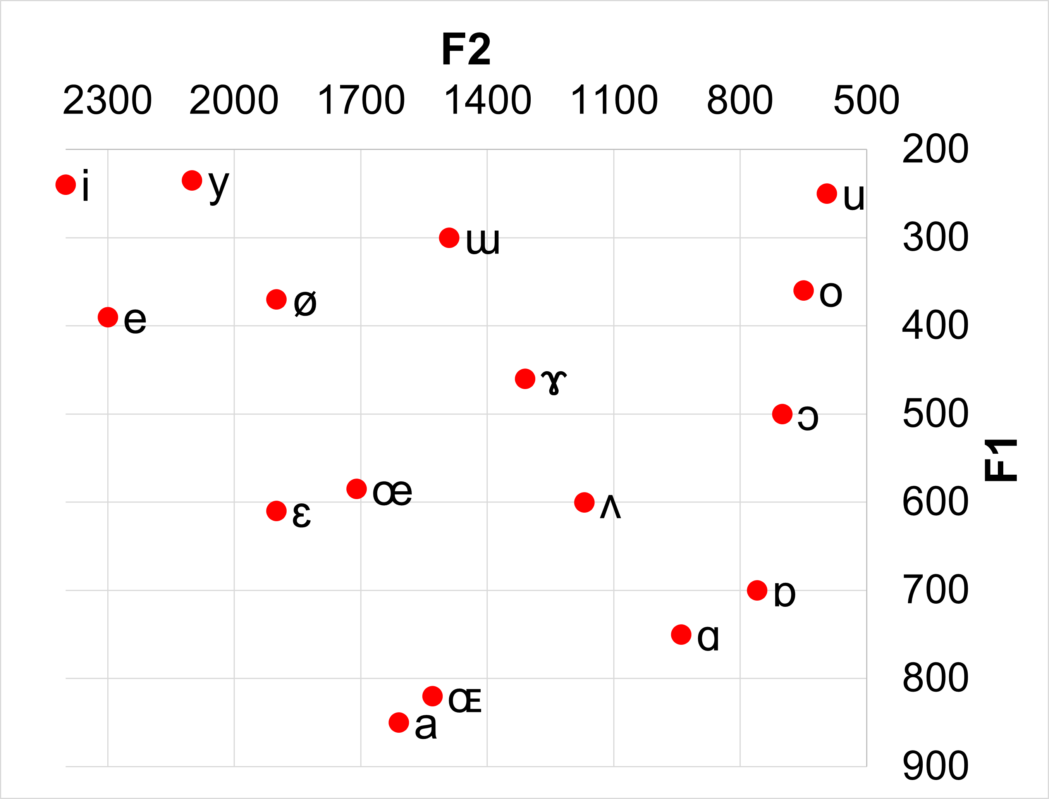
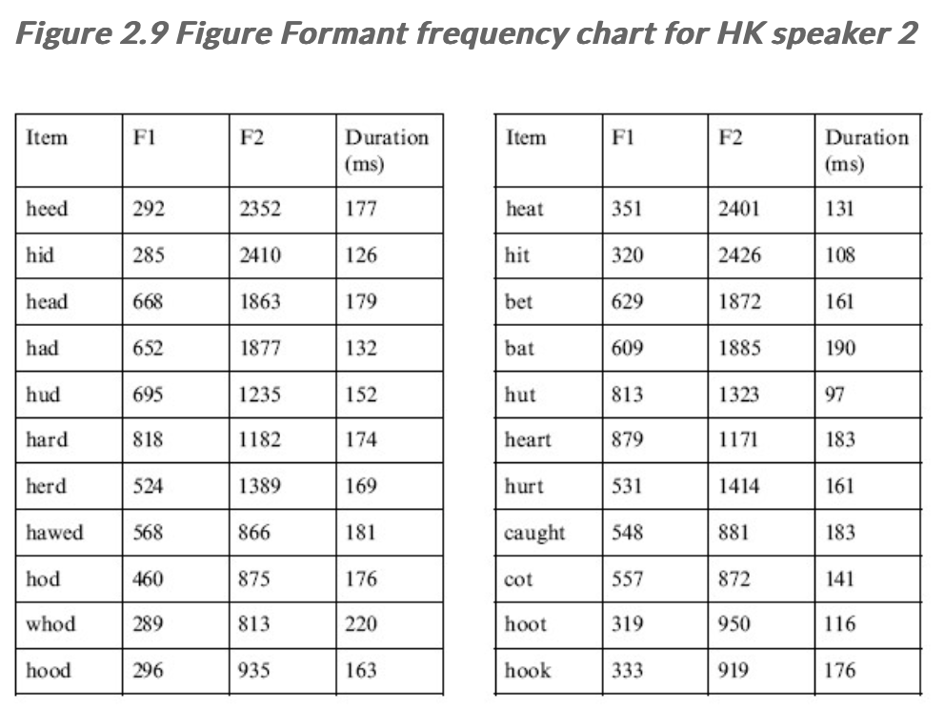
https://commons.wikimedia.org/wiki/File:Catford_formant_plot.png
https://corpus.eduhk.hk/english_pronunciation/index.php/2-2-formants-of-vowels/

Slide 6
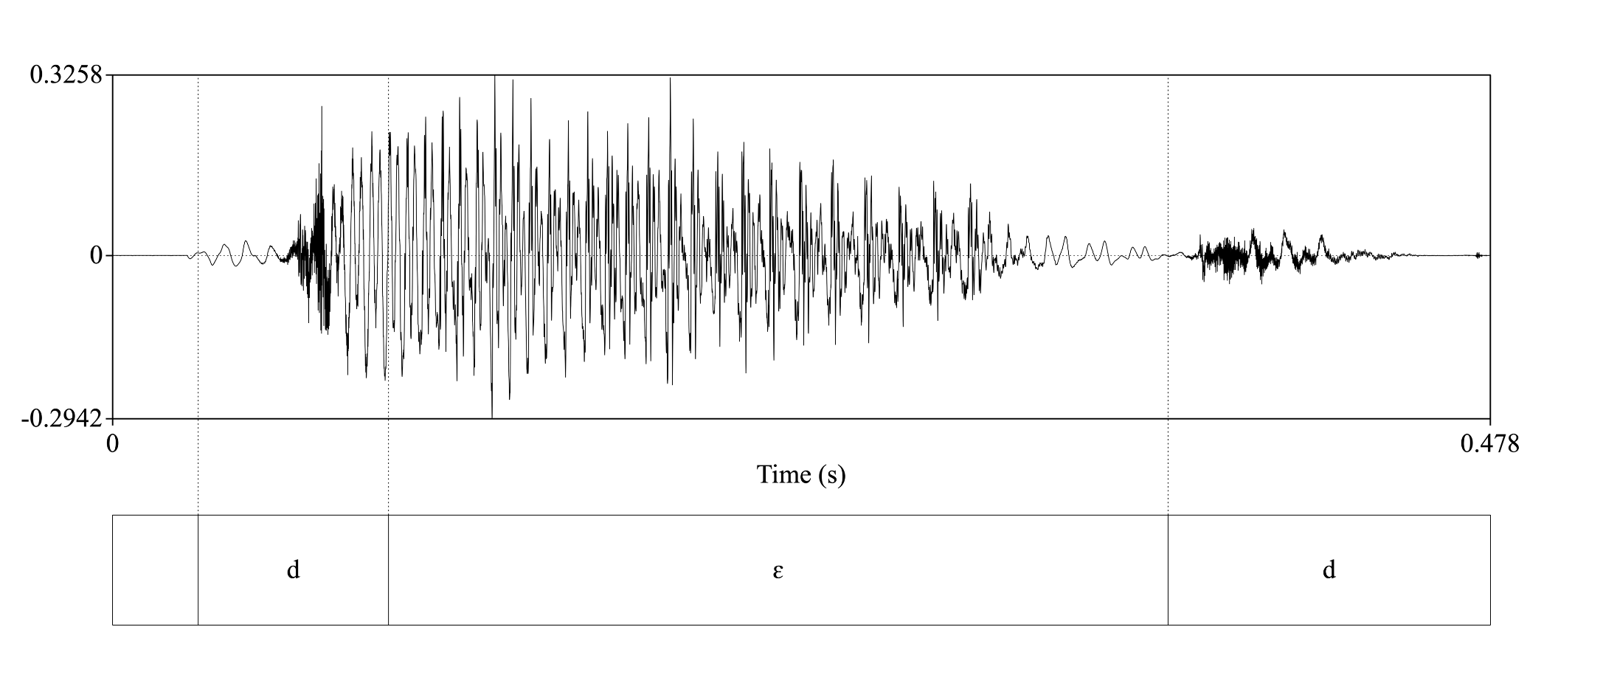
3. Analysis of the word “dead” acoustically.
3.1. What amplitudes can be measured at the beginning, middle, and end of the sounds?

Slide 7
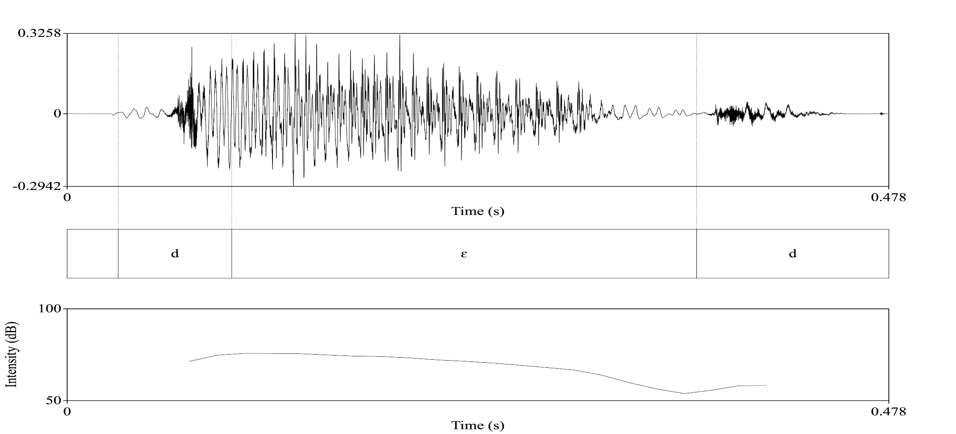
3. Analyze the word “dead” acoustically.
3.2. Draw the time-dependent intensity curve.

Slide 8
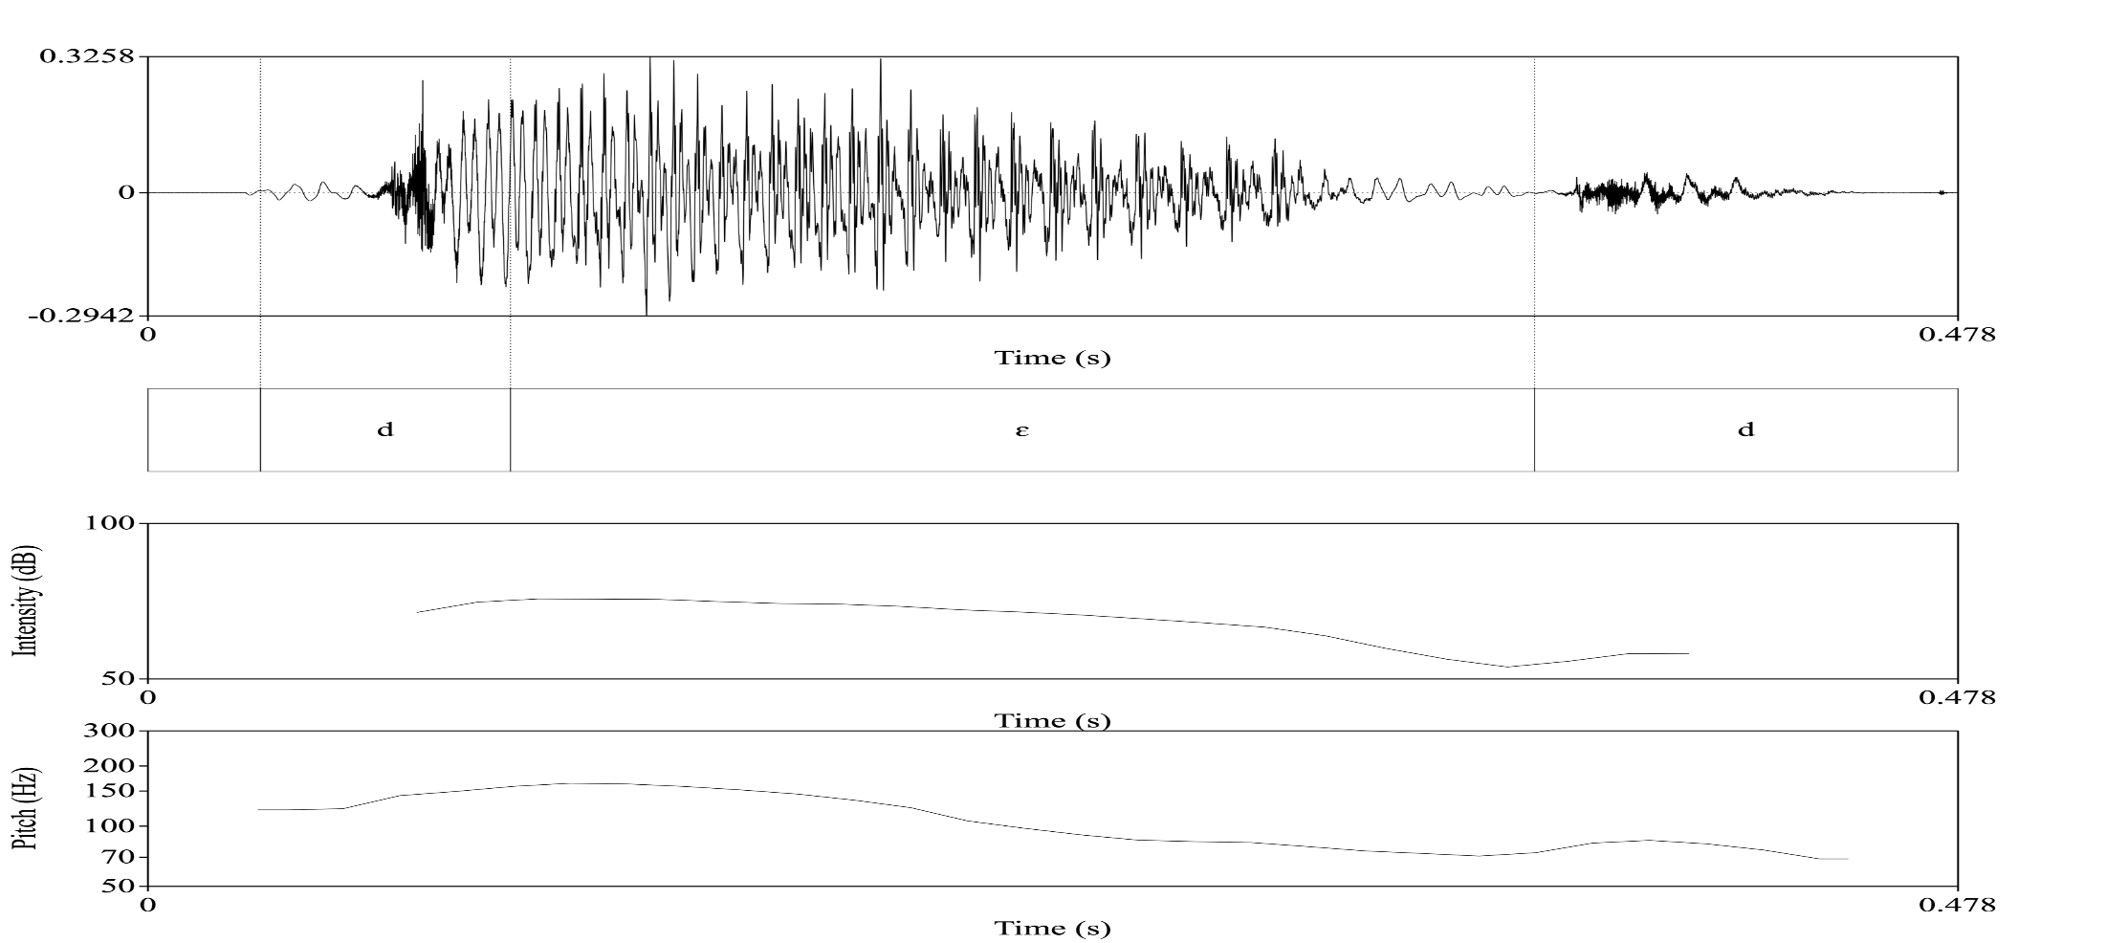
3. Analyze the word “dead” acoustically.
3.3. Draw the pitch

Slide 9

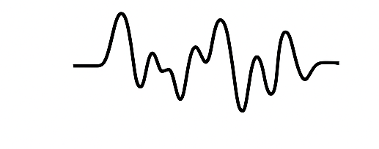
4. Designing a formant TTS synthesizer.
What control parameters should it operate with?
Suggested physical range for the parameters:
How often should control parameters be updated for machine-generated speech?
Text
“Hello Dr. Musk, how are you?”
Text Normalization
“Hello Doctor Musk, how are you?”
Phoneme Conversion
/həˈloʊ ˈdɑktɚ mʌsk haʊ ɑɹ ju/
Speech Parameters
Formant frequencies, Voicing, pitch, amplitude and timing
Formant synthesizer
https://espeak.sourceforge.net

Slide 10
5. TTS system using diphone
https://github.com/numediart/MBROLATOR
- What is a dyad/diphone?
Mbrola – speech synthesizer utilizes diphones as input rather than the direct text
Example: ”cat”
- What happens with the affricate sound? - where should the affricate sound be split to minimize distortion?
Example: ”church”
- How many dyads are needed to synthesize arbitrary English text?
- What happens if we have long consonant sounds?
Example: “pass”
https://voxpopuli.readthedocs.io/en/latest/espeak_mbrola.html

Slide 11
Sentence Intonation I
Declarative, Interrogative

Slide 12
Intonation
Duration of sound
Energy
Fundamental frequency (F0)
Voice quality

Slide 13

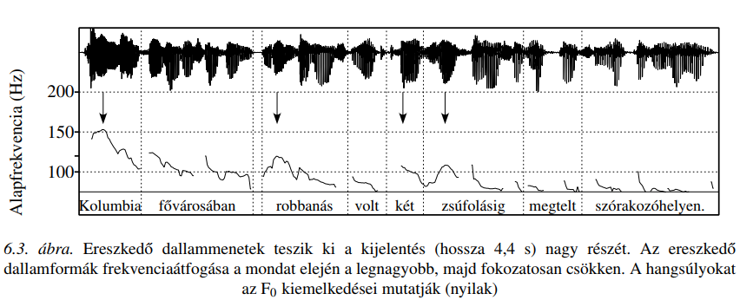
Word Stress and Sentence Intonation
fundamental frequency (F₀)
In the capital of Colombia there were explosions in two fully packed clubs
Figure 6.3. Descending melodic patterns make up most of the statement (4.4 s in length). The frequency range of the descending melodic patterns is largest at the beginning of the sentence and gradually decreases. The arrows indicate the F₀ (fundamental frequency) peaks.

Slide 14
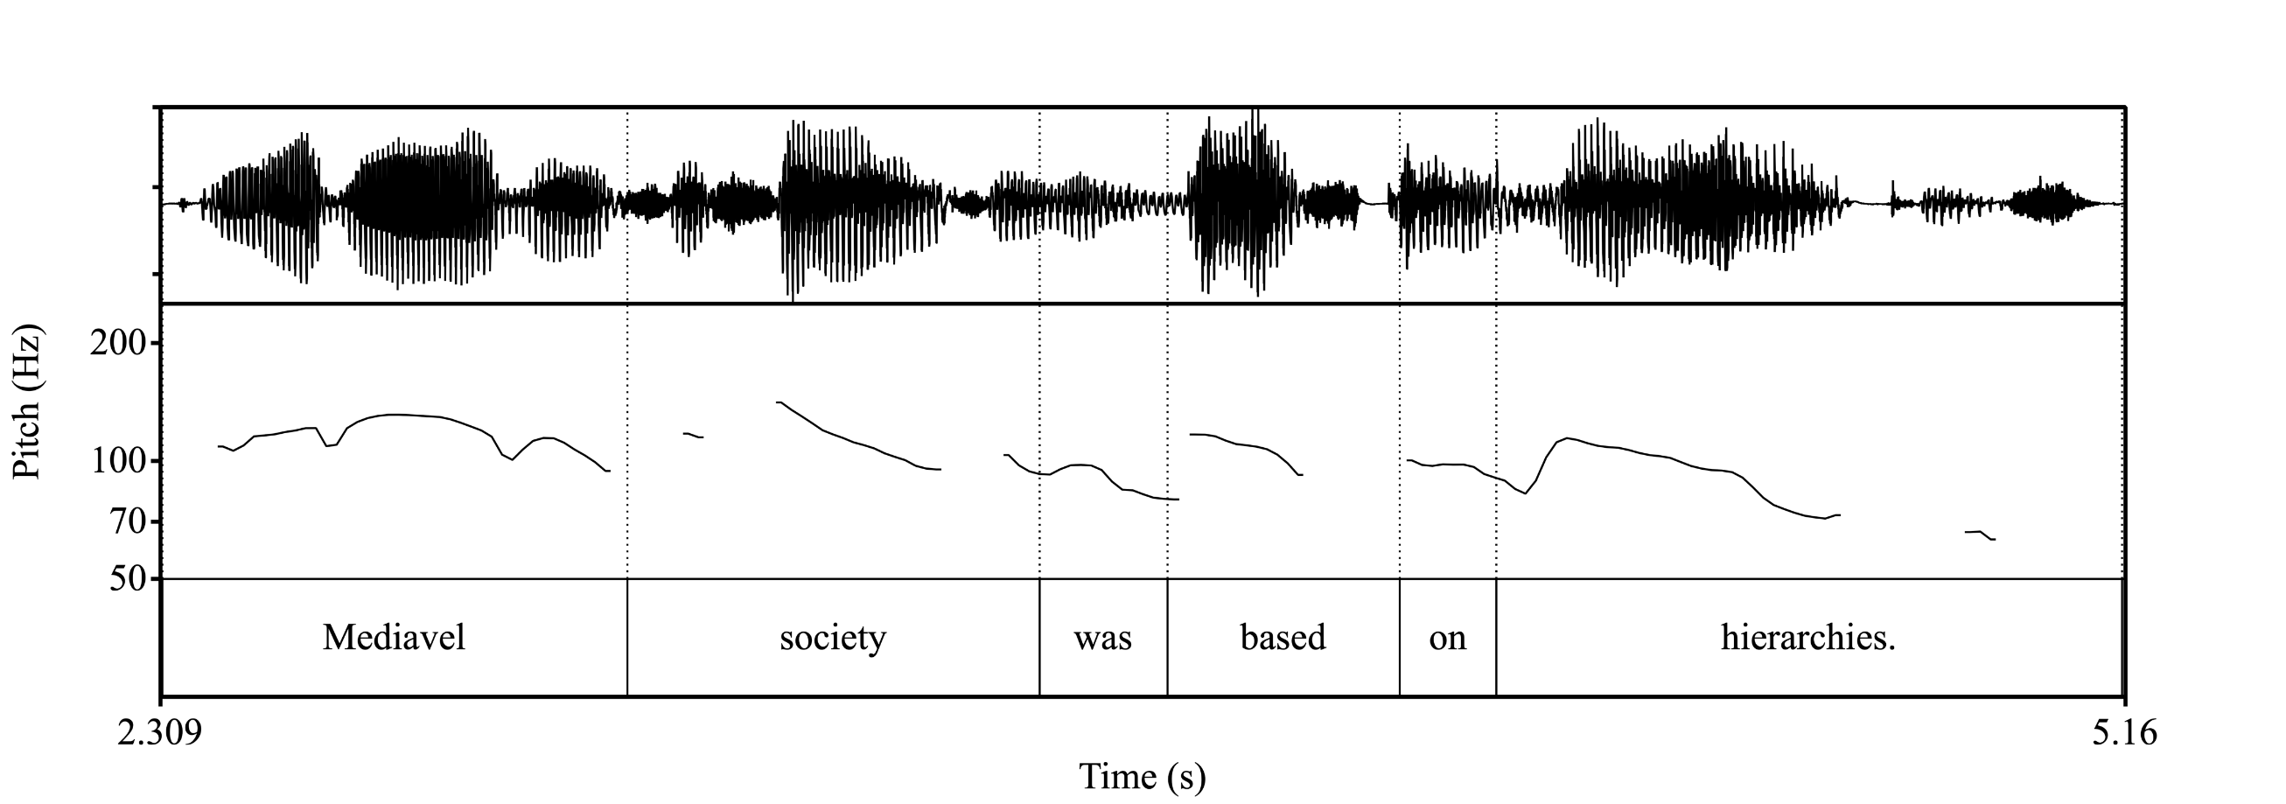
Word Stress and Sentence Intonation
Figure 5.1. Descending melodic patterns make up most of the statement. The frequency range of the descending melodic patterns is largest at the beginning of the sentence and gradually decreases. The arrows indicate the F₀ (fundamental frequency) peaks.

Slide 15
Types of Sentences (from an intonation perspective)
Declarative
Interrogative
Yes/No questions
WH-questions (supplementary questions)
Exclamatory, Imperative

Slide 16
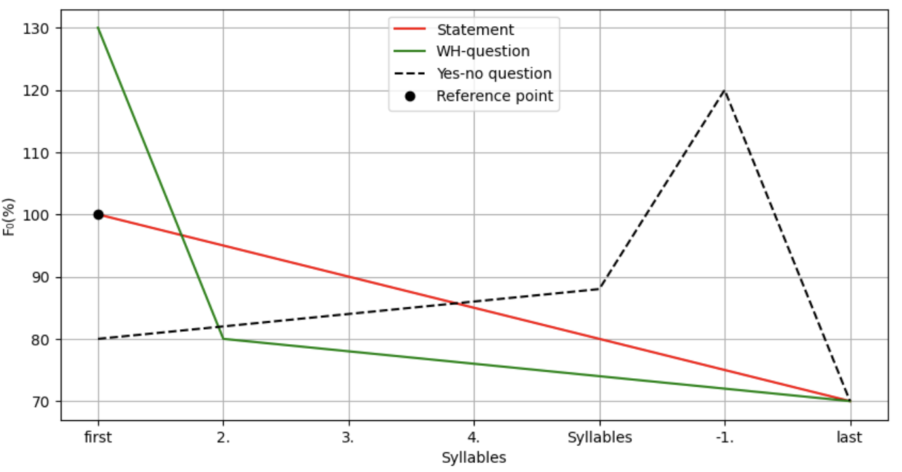
Figure 5.2. The schematic intonation patterns of statements and questions and their relationships to the statement as a reference point in terms of syllables. The reference point is the initial F₀ value of the statement (e.g., 100% = 120 Hz).

Slide 17
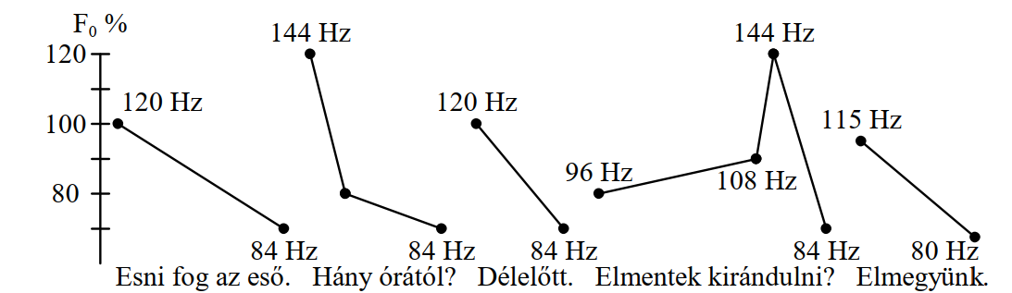
Characteristic Patterns of Sentence Intonation in Continuous Speech or Dialogue – Hungarian
It will rain.
What time?
Before noon.
Are you going hiking?
We will go.

Slide 18
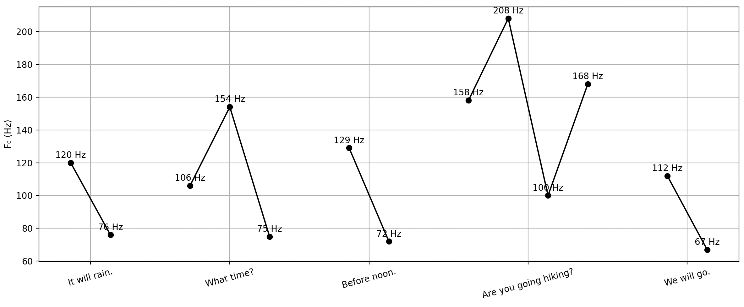
Characteristic Patterns of Sentence Intonation in Continuous Speech or Dialogue – English

Slide 19
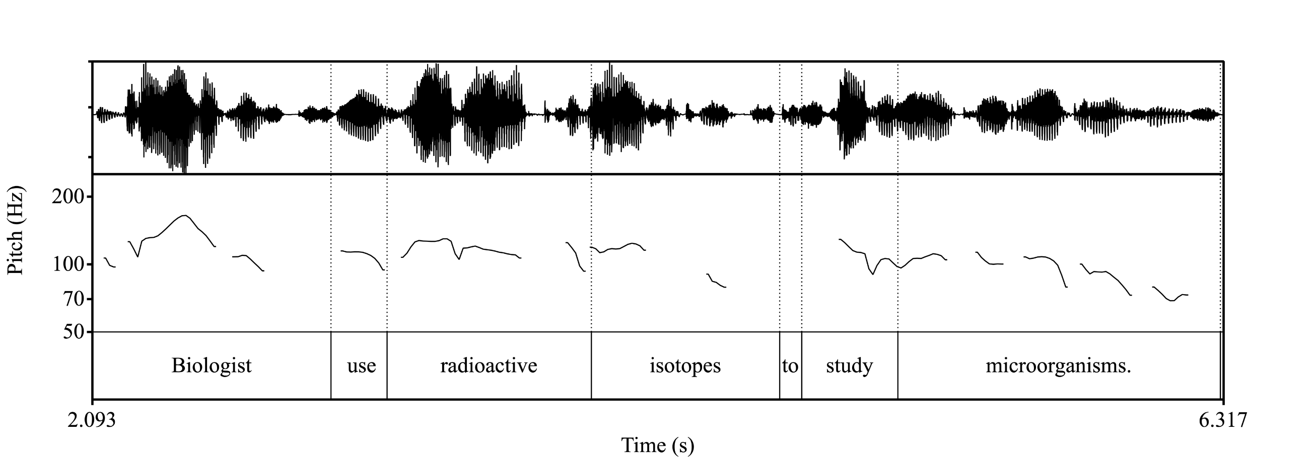
Example II.
Figure 5.4. The pitch contour of the sentence focus in the declarative sentence.

Slide 20
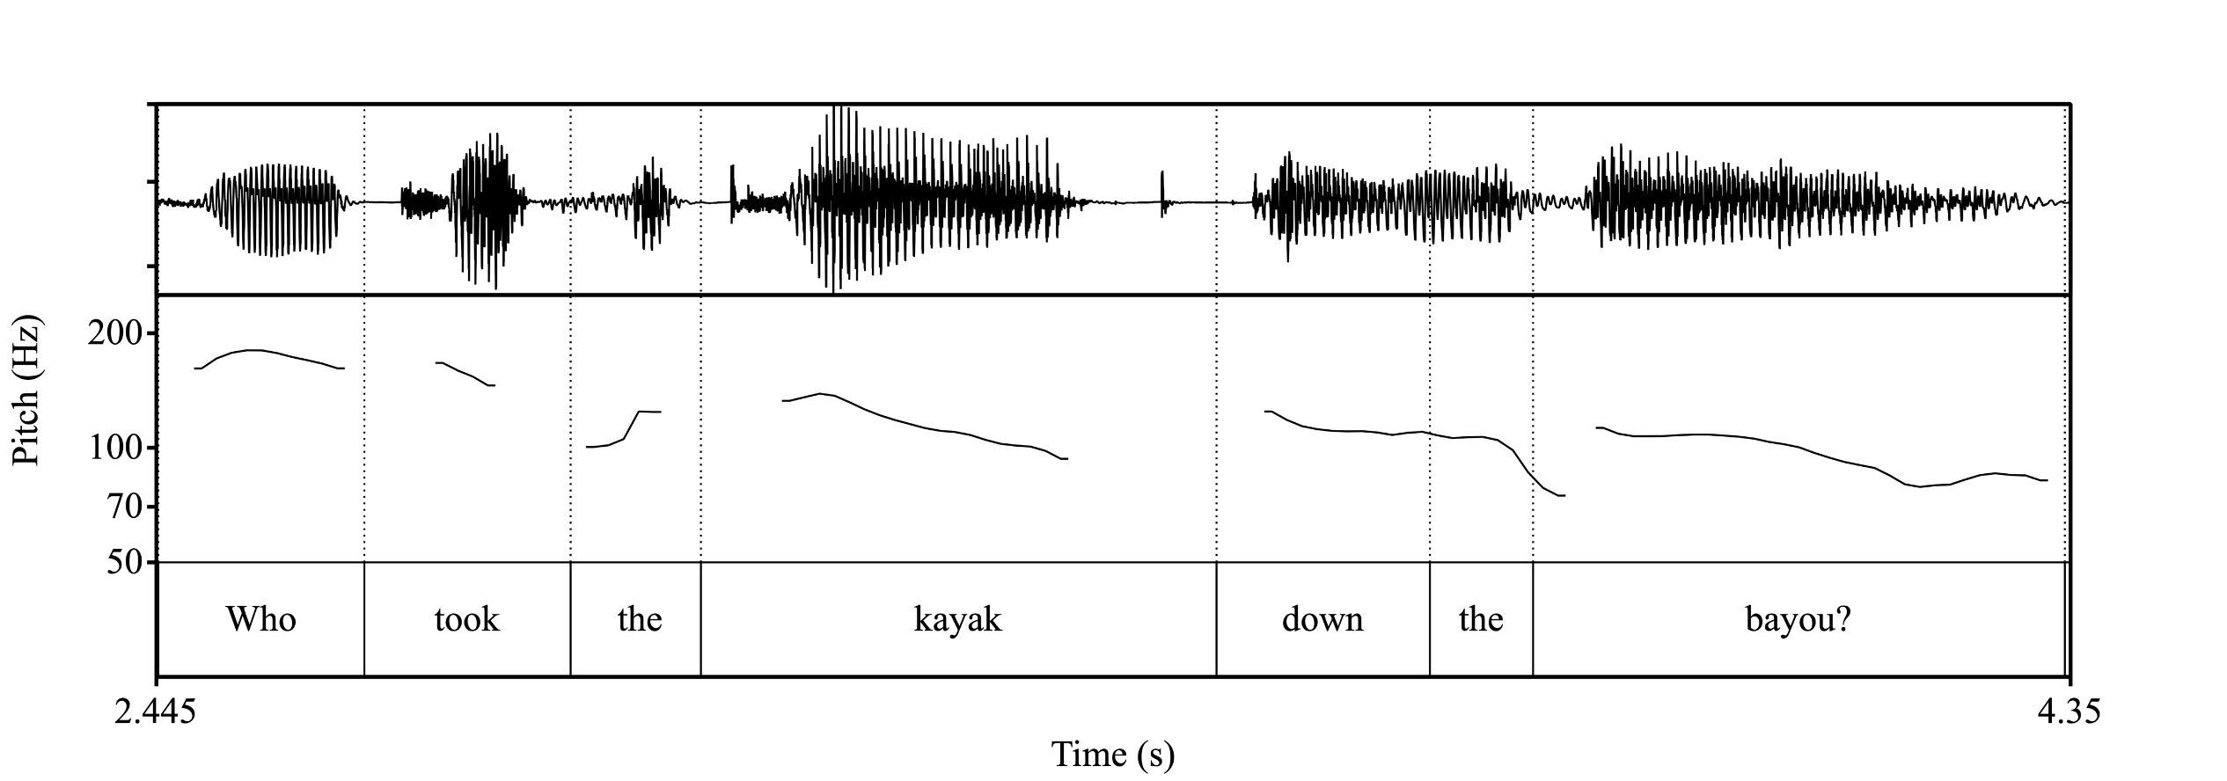
Questions – supplementary (WH-questions)
Figure 5.5. The melody contour of the WH-question and the related sentence part.

Slide 21
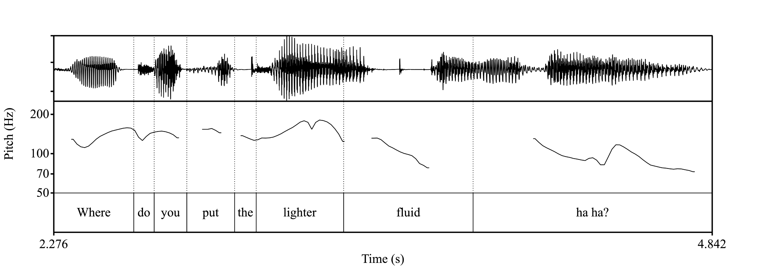
Questions – supplementary (WH-questions)
Figure 5.6. The melody contour of the WH-question with the introductory melody.

Slide 22
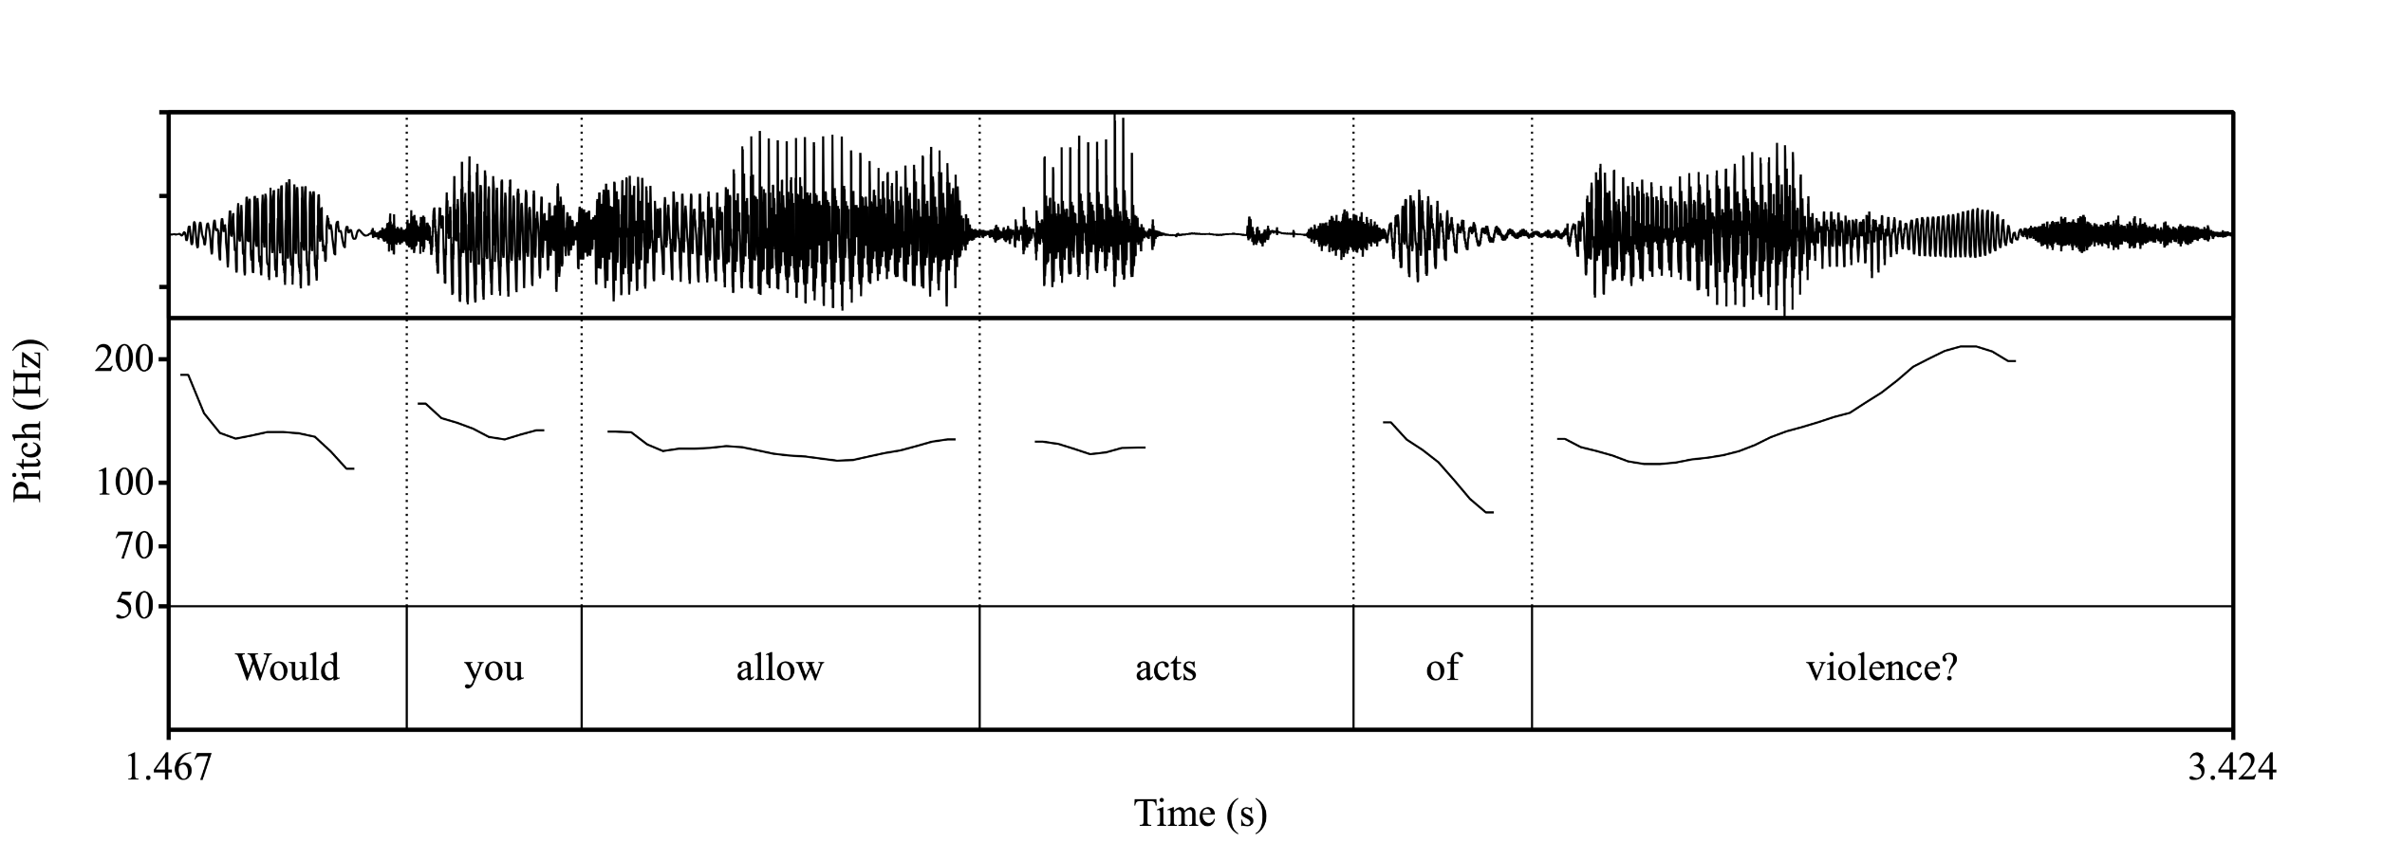
Questions – Yes/No
Figure 5.7. The melody contour of a special question form.

Slide 23
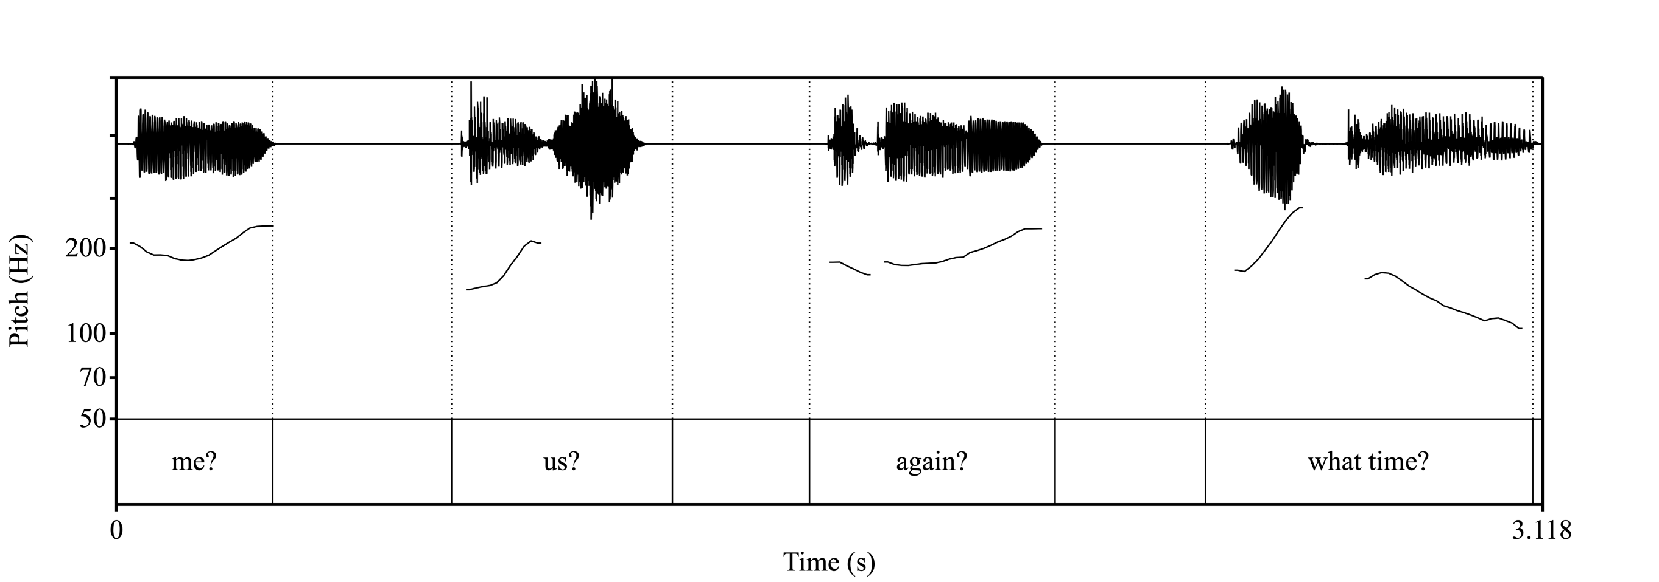
Questions – Short
Figure 5.8. The melodic contours of one- and two-syllable yes-no questions. The lengths of the sentences are 341 ms, 484 ms, 537 ms and 707 ms, respectively.

Slide 24
Short Sentences
Lengthened words (sounds):
Én? Te? Ki? Tegnap? (Me? You? Who? Yesterday?)
Ma. Holnap. Ő. (Today. Tomorrow. He/She/It.)

Slide 25
DNN TTS (Text-to-Speech using Deep Neural Networks)
Google Colab
Testing Piper TTS

Slide 26
Sentence Intonation II
Prosodic Units, Reading Numbers

Slide 27
Prosodic Unit
Intonation unit
Typically, we understand the part between commas
Comma Intonation
Purpose: Differentiate from thought endings, indicate continuation.
Rising F0 (pitch)
Pause
Falling F0 at the end

Slide 28
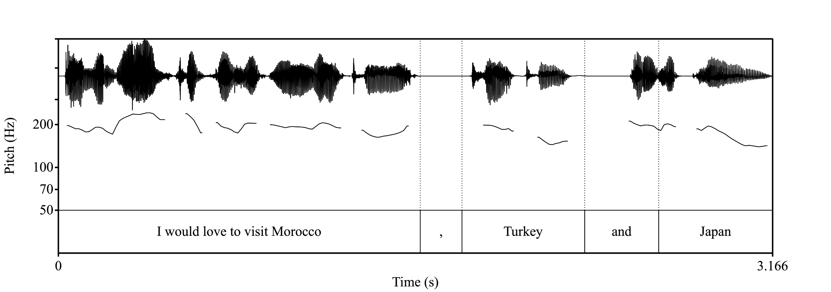
Example I – Comma intonation – one more

Slide 29
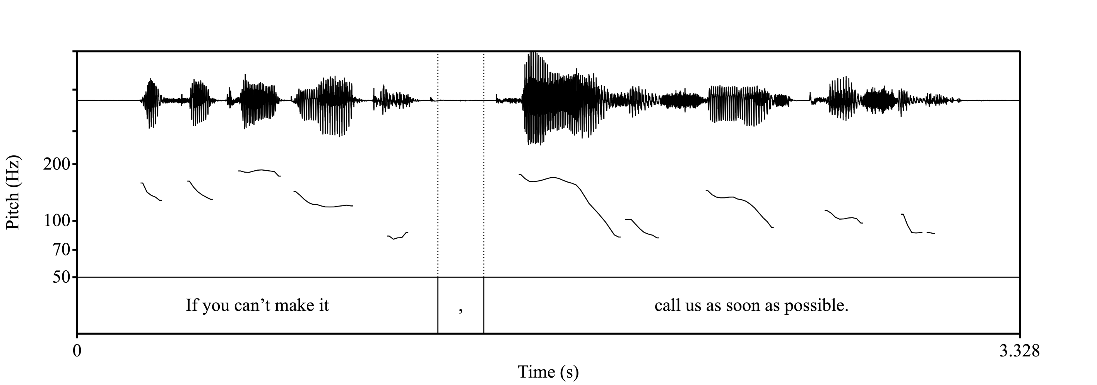
Example II – Comma intonation

Slide 30
Enumerating Numbers
Phone Numbers (in Hungarian Standard Form)
+36 50 123-45-67
Plus 36 50, 123, 45, 67.
Plusz harminchat ötven, százhuszonhárom, negyvenöt, hatvanhét.
(Plus thirty-six fifty, one hundred twenty-three, forty-five, sixty-seven.)
OR
Plusz harminchat, ötven, százhuszonhárom, negyvenöt, hatvanhét.
(Plus thirty-six, fifty, one hundred twenty-three, forty-five, sixty-seven.)
Phone Numbers (in English, natural form) - (in Hungarian, unnatural form)
+36 50 123-45-67
Plus 3, 6, 5, 0, 1, 2, 3, 4, 5, 6, 7.
Plus three, six, five, zero, one, two, three, four, five, six, seven.

Slide 31
Reading Numbers – Simple Form (Hungarian)
0,1,2,3,4,5,6,7,8,9
10,1x,20,2x,30,40,50,60,70,80,90
100
1 000
1 000 000
1 000 000 000
Σ 25 db (Total: 25 items)

Slide 32
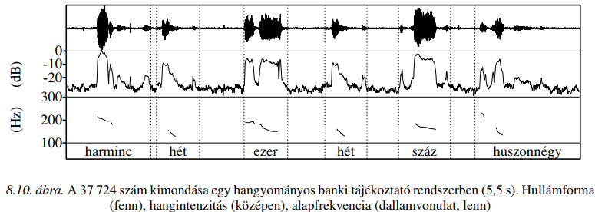
Low quality (Hungarian)
Figure 8.10. The pronunciation of the number 37,724 in a traditional bank information system (5.5 s). Waveform (top), sound intensity (middle), fundamental frequency (pitch contour, bottom). – 25 elements

Slide 33
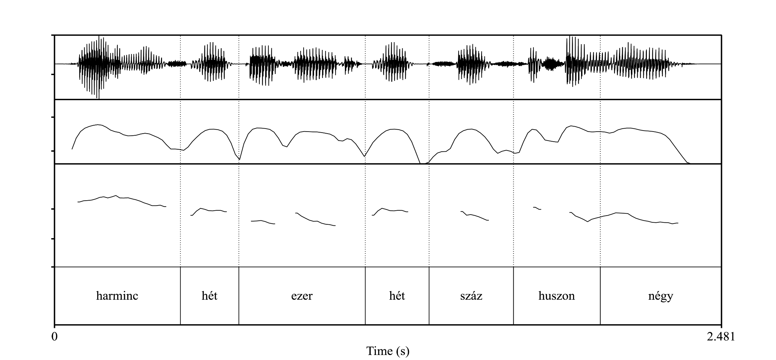
Reading numbers – good quality
Consideration of phonetic properties
Waveform (top), sound intensity (middle), fundamental frequency (pitch contour, bottom).
212 Hungarian elements

Slide 34
Element design (Hungarian)
3456
Három ezer négy száz ötven hat.
_ három e 3076 _ három ezer hetven hat .
m ezer n 453040 _négy száz ötven három ezer negyven
r négy sz 1400 ezer négy száz
gy(ty) száz ö
z ötven h
n hat .

Slide 35
Reading Numbers – Simple Form (English)
0,1,2,3,4,5,6,7,8,9
11,12,13,14,15,16,17,18,19
10,20,30,40,50,60,70,80,90
100
1 000
1 000 000
1 000 000 000
Σ 32 db (Total: 32 items)

Slide 36
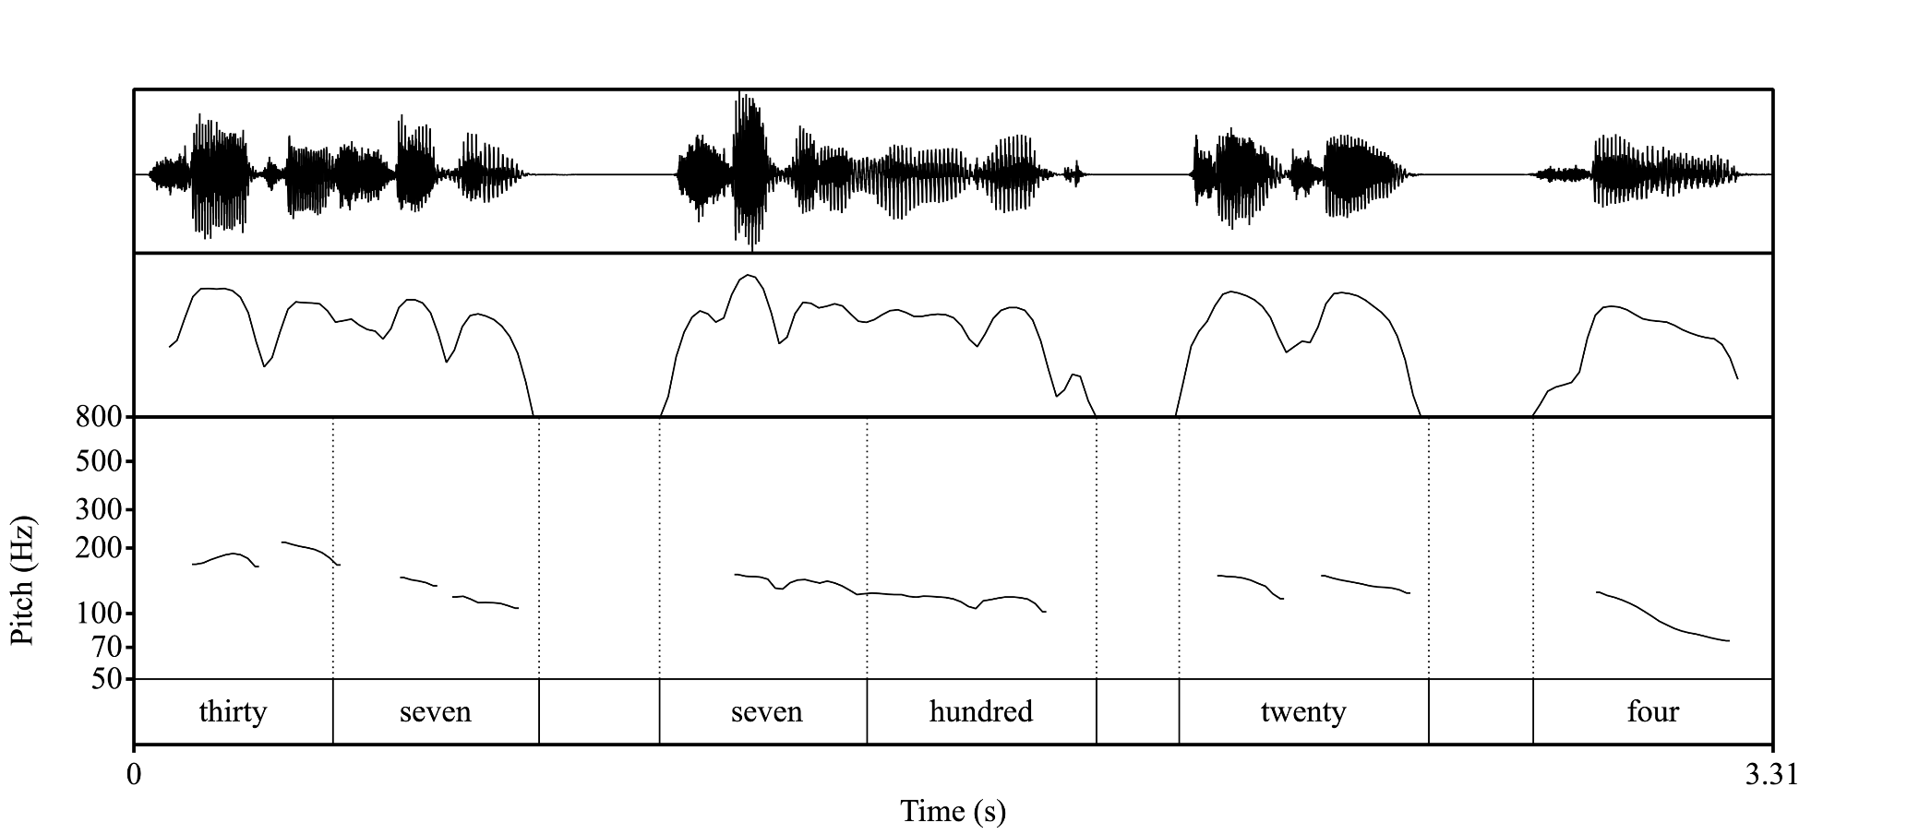
Low quality (English)
Figure 8.10. The pronunciation of the number 37,724 in a traditional bank information system. Waveform (top), sound intensity (middle), fundamental frequency (pitch contour, bottom). – 32 elements

Slide 37
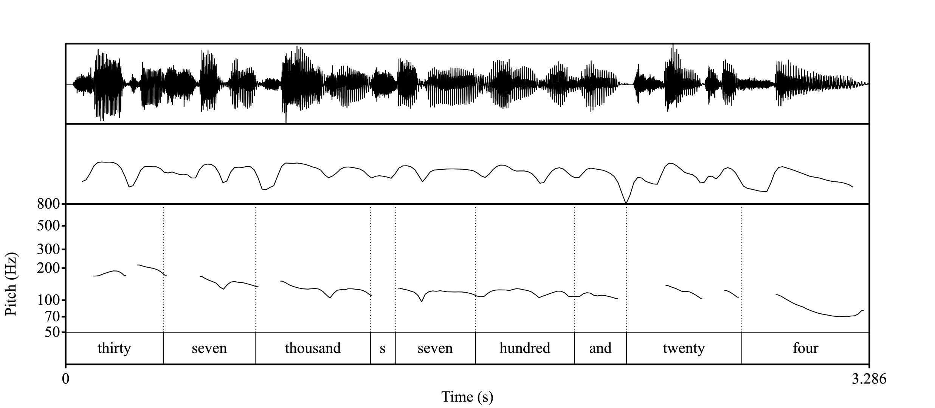
Reading numbers – good quality
Consideration of phonetic properties
Waveform (top), sound intensity (middle), fundamental frequency (pitch contour, bottom).

Slide 38
Element design (English) – Phone Number ending and starting example
3456
Three four five six r five s
Three thousand four hundred and fifty-six r hundred a
3455
Three four double five r double f e five _
Thirty-four hundred fifty-five d fifty - r hundred f

